Slide 1
Global sensitivity analysis in monte carlo radiation transport
Kayla Clements^{1,2}, Gianluca Geraci², Aaron Olson², Todd Palmer¹
1. Oregon State University, Corvallis OR
2. Sandia National Laboratories, Albuquerque NM
Mathematics and Computational Methods Applied to Nuclear Science and Engineering 2023
This work was supported by the Center for Exascale Monte-Carlo Neutron Transport (CEMeNT), a PSAAP-III project funded by the Department of Energy, grant number DE-NA003967.
Notes:
Title
Self-introduction: PhD student under Todd Palmer at Oregon State University, funded by CEMeNT. Mentors at Sandia National Lab are Gianluca and Aaron.

Slide 2
Overview
Variance-based global sensitivity analysis
Quantify variance in model output and attribute it to different uncertainty sources
Stochastic computational models
Identical inputs produce different results
Variance deconvolution
Separate variance contributions from stochastic solver and uncertainty sources

Slide 3
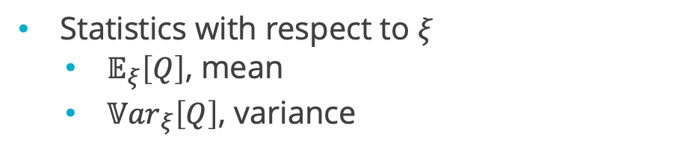
Background – global sensitivity analysis
Consider $Q=Q\left(ξ_{1}, ξ_{2}, ξ_{3}\right)$, function of $3$ uncertainty sources
Statistics with respect to $ξ$
$𝔼_{ξ}\left[Q\right]$, mean
${𝕍ar}_{ξ}\left[Q\right]$, variance

Slide 4
Background – global sensitivity analysis
Consider $Q=Q\left(ξ_{1}, ξ_{2}, ξ_{3}\right)$, function of $3$ uncertainty sources
Statistics with respect to $ξ$
$𝔼_{ξ}\left[Q\right]$, mean
${𝕍ar}_{ξ}\left[Q\right]$, variance
Conditional statistics for $ξ_{1}$
Fix $ξ_{1}$ as constant $→$ conditional mean $𝔼_{ξ_{2},ξ_{3}}\left[Q|ξ_{1}=constant\right]$

Slide 5
Background – global sensitivity analysis
Consider $Q=Q\left(ξ_{1}, ξ_{2}, ξ_{3}\right)$, function of $3$ uncertainty sources
Statistics with respect to $ξ$
$𝔼_{ξ}\left[Q\right]$, mean
${𝕍ar}_{ξ}\left[Q\right]$, variance
Conditional statistics for $ξ_{1}$
Fix $ξ_{1}$ as constant $→$ conditional mean $𝔼_{ξ_{2},ξ_{3}}\left[Q|ξ_{1}=constant\right]$
Variance over all possible $ξ_{1}→$ conditional variance ${𝕍ar}_{ξ_{1}}\left[𝔼_{ξ_{2},ξ_{3}}\left[Q|ξ_{1}\right]\right] ≝𝕍_{1}$

Slide 6
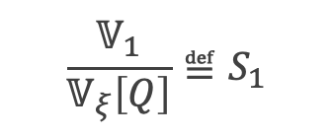
Background – global sensitivity analysis
Consider $Q=Q\left(ξ_{1}, ξ_{2}, ξ_{3}\right)$, function of $3$ uncertainty sources
Statistics with respect to $ξ$
$𝔼_{ξ}\left[Q\right]$, mean
${𝕍ar}_{ξ}\left[Q\right]$, variance
Conditional statistics for $ξ_{1}$
Fix $ξ_{1}$ as constant $→$ conditional mean $𝔼_{ξ_{2},ξ_{3}}\left[Q|ξ_{1}=constant\right]$
Variance over all possible $ξ_{1}→$ conditional variance ${𝕍ar}_{ξ_{1}}\left[𝔼_{ξ_{2},ξ_{3}}\left[Q|ξ_{1}\right]\right] ≝𝕍_{1}$
$$\frac{𝕍_{1}}{𝕍_{ξ}\left[Q\right]}≝S_{1}$$
Effect of $ξ_{1}→$ first-order sensitivity index (SI)

Slide 7

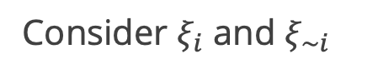
Background – sensitivity indices (SI)
General case
$$Q=Q\left(ξ_{1},ξ_{2},…,ξ_{d}\right)$$
Consider $ξ_{i}$ and $ξ_{∼i}$
not $i$
Notes:
https://arxiv.org/ftp/arxiv/papers/2203/2203.00639.pdf
S_i =
“Fractional reduction in V[Q] which would be obtained on average if xi_i could be fixed.”
“Fraction of variance that would remain on average if one received perfect information on all other factors”

Slide 8

Background – sensitivity indices (SI)
General case
$$Q=Q\left(ξ_{1},ξ_{2},…,ξ_{d}\right)$$
Consider $ξ_{i}$ and $ξ_{∼i}$
not $i$
First-order sensitivity index (SI)
Fractional contribution of $ξ_{i}$
$$S_{i}=\frac{{𝕍ar}_{ξ_{i}}\left[𝔼_{ξ_{∼i}}\left[Q|ξ_{i}\right]\right]}{{𝕍ar}_{ξ}\left[Q\right]}=\frac{𝕍_{i}}{𝕍_{ξ}\left[Q\right]}$$
Notes:
https://arxiv.org/ftp/arxiv/papers/2203/2203.00639.pdf
S_i =
“Fractional reduction in V[Q] which would be obtained on average if xi_i could be fixed.”
“Fraction of variance that would remain on average if one received perfect information on all other factors”

Slide 9



Background – sensitivity indices (SI)
General case
$$Q=Q\left(ξ_{1},ξ_{2},…,ξ_{d}\right)$$
Consider $ξ_{i}$ and $ξ_{∼i}$
not $i$
First-order sensitivity index (SI)
Total sensitivity index (SI)
Fractional contribution of $ξ_{i}$
Fractional contribution of $ξ_{i}$ and all of its interactions
not $i$
$$S_{i}=\frac{{𝕍ar}_{ξ_{i}}\left[𝔼_{ξ_{∼i}}\left[Q|ξ_{i}\right]\right]}{{𝕍ar}_{ξ}\left[Q\right]}=\frac{𝕍_{i}}{𝕍_{ξ}\left[Q\right]}$$
$$T_{i}=1−\frac{𝕍_{ξ_{\sim i}}\left[𝔼_{ξ_{i}}\left[Q|ξ_{∼i}\right]\right]}{{𝕍ar}_{ξ}\left[Q\right]}=1−\frac{𝕍_{∼i}}{𝕍_{ξ}\left[Q\right]}$$
Notes:
https://arxiv.org/ftp/arxiv/papers/2203/2203.00639.pdf
S_i =
“Fractional reduction in V[Q] which would be obtained on average if xi_i could be fixed.”
“Fraction of variance that would remain on average if one received perfect information on all other factors”

Slide 10
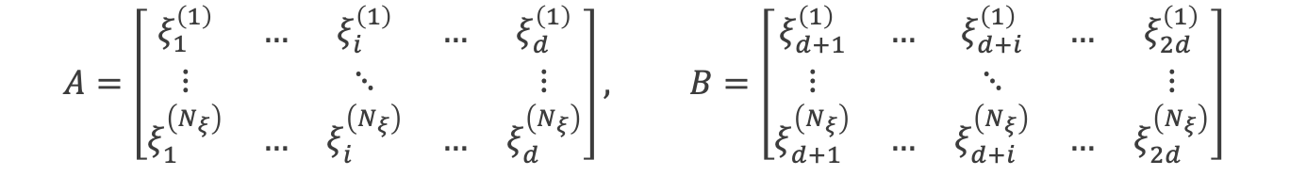
Background – Saltelli method^{(GSA primer, 2008)}
Sampling-based estimation for $S_{i}$ and $T_{i}$
Given $Q=Q\left(ξ_{1}, ξ_{2}, …, ξ_{d}\right)$, generate a $\left(N_{ξ},2d\right)$ matrix of independent input samples and define matrices $A$ and $B$, each containing half of the sample
$$A=\left[\begin{matrix}ξ_{1}^{\left(1\right)} & … & ξ_{i}^{\left(1\right)} & … & ξ_{d}^{\left(1\right)} \\ ⋮ & & ⋱ & & ⋮ \\ ξ_{1}^{\left(N_{ξ}\right)} & … & ξ_{i}^{\left(N_{ξ}\right)} & … & ξ_{d}^{\left(N_{ξ}\right)}\end{matrix}\right], B=\left[\begin{matrix}ξ_{d+1}^{\left(1\right)} & … & ξ_{d+i}^{\left(1\right)} & … & ξ_{2d}^{\left(1\right)} \\ ⋮ & & ⋱ & & ⋮ \\ ξ_{d+1}^{\left(N_{ξ}\right)} & … & ξ_{d+i}^{\left(N_{ξ}\right)} & … & ξ_{2d}^{\left(N_{ξ}\right)}\end{matrix}\right]$$

Slide 11

Background – Saltelli method^{(GSA primer, 2008)}
Sampling-based estimation for $S_{i}$ and $T_{i}$
Given $Q=Q\left(ξ_{1}, ξ_{2}, …, ξ_{d}\right)$, generate a $\left(N_{ξ},2d\right)$ matrix of independent input samples and define matrices $A$ and $B$, each containing half of the sample
$$A=\left[\begin{matrix}ξ_{1}^{\left(1\right)} & … & ξ_{i}^{\left(1\right)} & … & ξ_{d}^{\left(1\right)} \\ ⋮ & & ⋱ & & ⋮ \\ ξ_{1}^{\left(N_{ξ}\right)} & … & ξ_{i}^{\left(N_{ξ}\right)} & … & ξ_{d}^{\left(N_{ξ}\right)}\end{matrix}\right], B=\left[\begin{matrix}ξ_{d+1}^{\left(1\right)} & … & ξ_{d+i}^{\left(1\right)} & … & ξ_{2d}^{\left(1\right)} \\ ⋮ & & ⋱ & & ⋮ \\ ξ_{d+1}^{\left(N_{ξ}\right)} & … & ξ_{d+i}^{\left(N_{ξ}\right)} & … & ξ_{2d}^{\left(N_{ξ}\right)}\end{matrix}\right]$$
For all $d$inputs, create matrix $C_{i}$ using all columns of $B$ except the $i$th column, which is from $A$
$$C_{i}=\left[\begin{matrix}ξ_{d+1}^{\left(1\right)} & … & ξ_{i}^{\left(1\right)} & … & ξ_{2d}^{\left(1\right)} \\ ⋮ & & ⋱ & & ⋮ \\ ξ_{d+1}^{\left(N_{ξ}\right)} & … & ξ_{i}^{\left(N_{ξ}\right)} & … & ξ_{2d}^{\left(N_{ξ}\right)}\end{matrix}\right]$$

Slide 12

Background – Saltelli method^{(GSA primer, 2008)}
Sampling-based estimation for $S_{i}$ and $T_{i}$
Given $Q=Q\left(ξ_{1}, ξ_{2}, …, ξ_{d}\right)$, generate a $\left(N_{ξ},2d\right)$ matrix of independent input samples and define matrices $A$ and $B$, each containing half of the sample
$$A=\left[\begin{matrix}ξ_{1}^{\left(1\right)} & … & ξ_{i}^{\left(1\right)} & … & ξ_{d}^{\left(1\right)} \\ ⋮ & & ⋱ & & ⋮ \\ ξ_{1}^{\left(N_{ξ}\right)} & … & ξ_{i}^{\left(N_{ξ}\right)} & … & ξ_{d}^{\left(N_{ξ}\right)}\end{matrix}\right], B=\left[\begin{matrix}ξ_{d+1}^{\left(1\right)} & … & ξ_{d+i}^{\left(1\right)} & … & ξ_{2d}^{\left(1\right)} \\ ⋮ & & ⋱ & & ⋮ \\ ξ_{d+1}^{\left(N_{ξ}\right)} & … & ξ_{d+i}^{\left(N_{ξ}\right)} & … & ξ_{2d}^{\left(N_{ξ}\right)}\end{matrix}\right]$$
For all $d$inputs, create matrix $C_{i}$ using all columns of $B$ except the $i$th column, which is from $A$
$$C_{i}=\left[\begin{matrix}ξ_{d+1}^{\left(1\right)} & … & ξ_{i}^{\left(1\right)} & … & ξ_{2d}^{\left(1\right)} \\ ⋮ & & ⋱ & & ⋮ \\ ξ_{d+1}^{\left(N_{ξ}\right)} & … & ξ_{i}^{\left(N_{ξ}\right)} & … & ξ_{2d}^{\left(N_{ξ}\right)}\end{matrix}\right]$$
Compute model output vector $y$ of dimension $\left(N_{ξ},1\right)$ for $A$, $B$, and all $C_{i}$
$$y_{A}=\left[\begin{matrix}Q\left(ξ_{1}^{(1)},…,ξ_{i}^{\left(1\right)},…,ξ_{d}^{(1)}\right) \\ ⋮ \\ Q\left(ξ_{1}^{(N_{ξ})},…,ξ_{i}^{\left(N_{ξ}\right)},…,ξ_{d}^{(N_{ξ})}\right)\end{matrix}\right]$$

Slide 13
Background – Saltelli method^{(GSA primer, 2008)}
Sampling-based estimation for $S_{i}$ and $T_{i}$
Use sampling estimators to estimate first-order and total SIs [1]

Slide 14
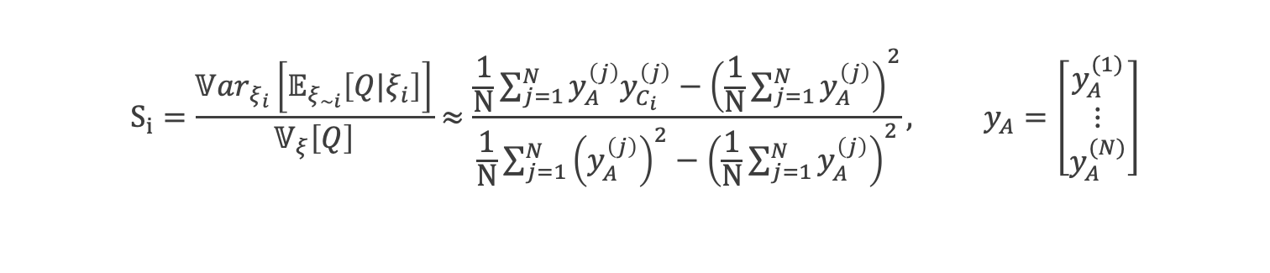
Background – Saltelli method^{(GSA primer, 2008)}
Sampling-based estimation for $S_{i}$ and $T_{i}$
Use sampling estimators to estimate first-order and total SIs [1]
$$S_{i}=\frac{{𝕍ar}_{ξ_{i}}\left[𝔼_{ξ_{∼i}}\left[Q|ξ_{i}\right]\right]}{𝕍_{ξ}\left[Q\right]}≈\frac{\frac{1}{N}\sum_{j=1}^{N}{y_{A}^{\left(j\right)}y_{C_{i}}^{\left(j\right)}}−{\left(\frac{1}{N}\sum_{j=1}^{N}{y_{A}^{\left(j\right)}}\right)}^{2}}{\frac{1}{N}\sum_{j=1}^{N}{{\left(y_{A}^{\left(j\right)}\right)}^{2}}−{\left(\frac{1}{N}\sum_{j=1}^{N}{y_{A}^{\left(j\right)}}\right)}^{2}}, y_{A}=\left[\begin{matrix}y_{A}^{(1)} \\ ⋮ \\ y_{A}^{(N)}\end{matrix}\right]$$

Slide 15
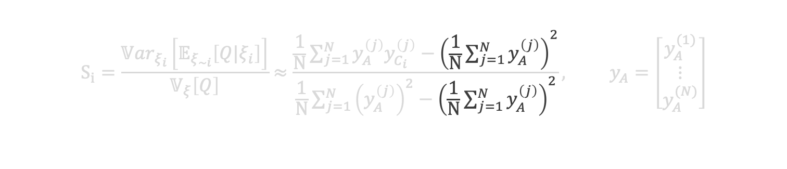
Background – Saltelli method^{(GSA primer, 2008)}
Sampling-based estimation for $S_{i}$ and $T_{i}$
Use sampling estimators to estimate first-order and total SIs [1]
$$S_{i}=\frac{{𝕍ar}_{ξ_{i}}\left[𝔼_{ξ_{∼i}}\left[Q|ξ_{i}\right]\right]}{𝕍_{ξ}\left[Q\right]}≈\frac{\frac{1}{N}\sum_{j=1}^{N}{y_{A}^{\left(j\right)}y_{C_{i}}^{\left(j\right)}}−{\left(\frac{1}{N}\sum_{j=1}^{N}{y_{A}^{\left(j\right)}}\right)}^{2}}{\frac{1}{N}\sum_{j=1}^{N}{{\left(y_{A}^{\left(j\right)}\right)}^{2}}−{\left(\frac{1}{N}\sum_{j=1}^{N}{y_{A}^{\left(j\right)}}\right)}^{2}}, y_{A}=\left[\begin{matrix}y_{A}^{(1)} \\ ⋮ \\ y_{A}^{(N)}\end{matrix}\right]$$

Slide 16
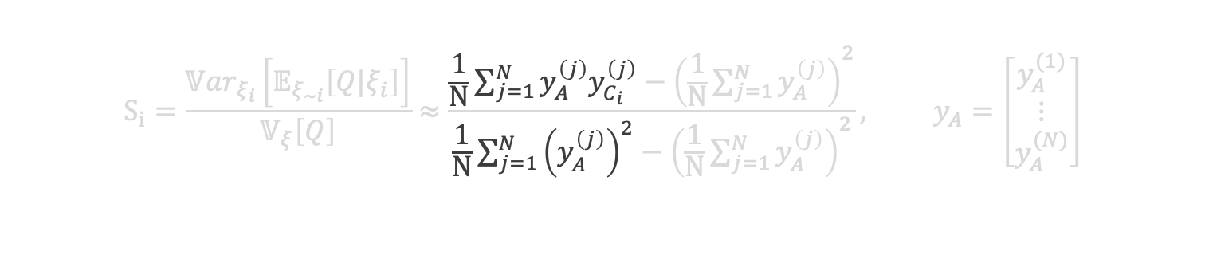
Background – Saltelli method^{(GSA primer, 2008)}
Sampling-based estimation for $S_{i}$ and $T_{i}$
Use sampling estimators to estimate first-order and total SIs [1]
$$S_{i}=\frac{{𝕍ar}_{ξ_{i}}\left[𝔼_{ξ_{∼i}}\left[Q|ξ_{i}\right]\right]}{𝕍_{ξ}\left[Q\right]}≈\frac{\frac{1}{N}\sum_{j=1}^{N}{y_{A}^{\left(j\right)}y_{C_{i}}^{\left(j\right)}}−{\left(\frac{1}{N}\sum_{j=1}^{N}{y_{A}^{\left(j\right)}}\right)}^{2}}{\frac{1}{N}\sum_{j=1}^{N}{{\left(y_{A}^{\left(j\right)}\right)}^{2}}−{\left(\frac{1}{N}\sum_{j=1}^{N}{y_{A}^{\left(j\right)}}\right)}^{2}}, y_{A}=\left[\begin{matrix}y_{A}^{(1)} \\ ⋮ \\ y_{A}^{(N)}\end{matrix}\right]$$

Slide 17
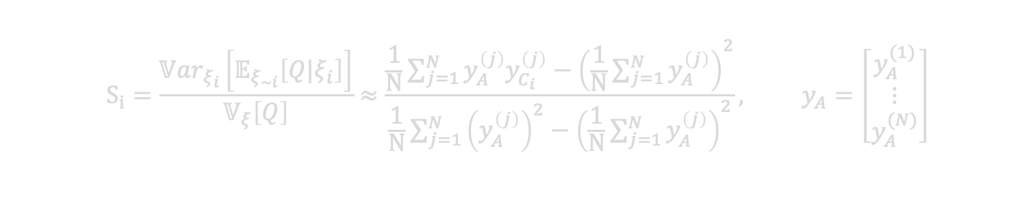
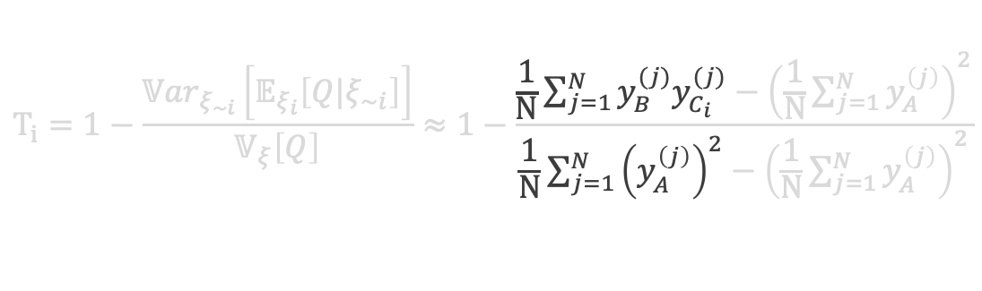
Background – Saltelli method^{(GSA primer, 2008)}
Sampling-based estimation for $S_{i}$ and $T_{i}$
Use sampling estimators to estimate first-order and total SIs [1]
$$S_{i}=\frac{{𝕍ar}_{ξ_{i}}\left[𝔼_{ξ_{∼i}}\left[Q|ξ_{i}\right]\right]}{𝕍_{ξ}\left[Q\right]}≈\frac{\frac{1}{N}\sum_{j=1}^{N}{y_{A}^{\left(j\right)}y_{C_{i}}^{\left(j\right)}}−{\left(\frac{1}{N}\sum_{j=1}^{N}{y_{A}^{\left(j\right)}}\right)}^{2}}{\frac{1}{N}\sum_{j=1}^{N}{{\left(y_{A}^{\left(j\right)}\right)}^{2}}−{\left(\frac{1}{N}\sum_{j=1}^{N}{y_{A}^{\left(j\right)}}\right)}^{2}}, y_{A}=\left[\begin{matrix}y_{A}^{(1)} \\ ⋮ \\ y_{A}^{(N)}\end{matrix}\right]$$
$$T_{i}=1−\frac{{𝕍ar}_{ξ_{\sim i}}\left[𝔼_{ξ_{i}}\left[Q|ξ_{∼i}\right]\right]}{𝕍_{ξ}\left[Q\right]}≈1−\frac{\frac{1}{N}\sum_{j=1}^{N}{y_{B}^{(j)}y_{C_{i}}^{(j)}}−{\left(\frac{1}{N}\sum_{j=1}^{N}{y_{A}^{\left(j\right)}}\right)}^{2}}{\frac{1}{N}\sum_{j=1}^{N}{{\left(y_{A}^{\left(j\right)}\right)}^{2}}−{\left(\frac{1}{N}\sum_{j=1}^{N}{y_{A}^{\left(j\right)}}\right)}^{2}}$$

Slide 18
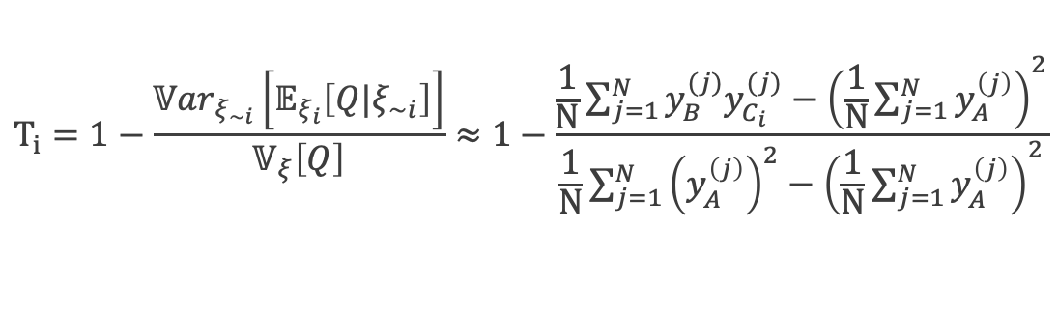
Background – Saltelli method^{(GSA primer, 2008)}
Sampling-based estimation for $S_{i}$ and $T_{i}$
Use sampling estimators to estimate first-order and total SIs [1]
$$S_{i}=\frac{{𝕍ar}_{ξ_{i}}\left[𝔼_{ξ_{∼i}}\left[Q|ξ_{i}\right]\right]}{𝕍_{ξ}\left[Q\right]}≈\frac{\frac{1}{N}\sum_{j=1}^{N}{y_{A}^{\left(j\right)}y_{C_{i}}^{\left(j\right)}}−{\left(\frac{1}{N}\sum_{j=1}^{N}{y_{A}^{\left(j\right)}}\right)}^{2}}{\frac{1}{N}\sum_{j=1}^{N}{{\left(y_{A}^{\left(j\right)}\right)}^{2}}−{\left(\frac{1}{N}\sum_{j=1}^{N}{y_{A}^{\left(j\right)}}\right)}^{2}}, y_{A}=\left[\begin{matrix}y_{A}^{(1)} \\ ⋮ \\ y_{A}^{(N)}\end{matrix}\right]$$
$$T_{i}=1−\frac{{𝕍ar}_{ξ_{\sim i}}\left[𝔼_{ξ_{i}}\left[Q|ξ_{∼i}\right]\right]}{𝕍_{ξ}\left[Q\right]}≈1−\frac{\frac{1}{N}\sum_{j=1}^{N}{y_{B}^{(j)}y_{C_{i}}^{(j)}}−{\left(\frac{1}{N}\sum_{j=1}^{N}{y_{A}^{\left(j\right)}}\right)}^{2}}{\frac{1}{N}\sum_{j=1}^{N}{{\left(y_{A}^{\left(j\right)}\right)}^{2}}−{\left(\frac{1}{N}\sum_{j=1}^{N}{y_{A}^{\left(j\right)}}\right)}^{2}}$$

Slide 19
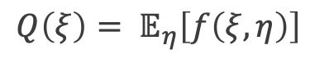
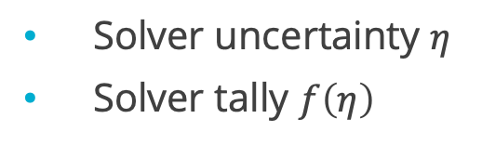
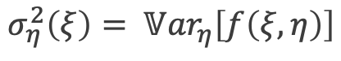
Background – stochastic solvers
Solver uncertainty $η$
Solver tally $f\left(η\right)$
$$Q\left(ξ\right)= 𝔼_{η}\left[f\left(ξ,η\right)\right]$$
$$σ_{η}^{2}\left(ξ\right)= {𝕍ar}_{η}\left[f\left(ξ,η\right)\right]$$

Slide 20
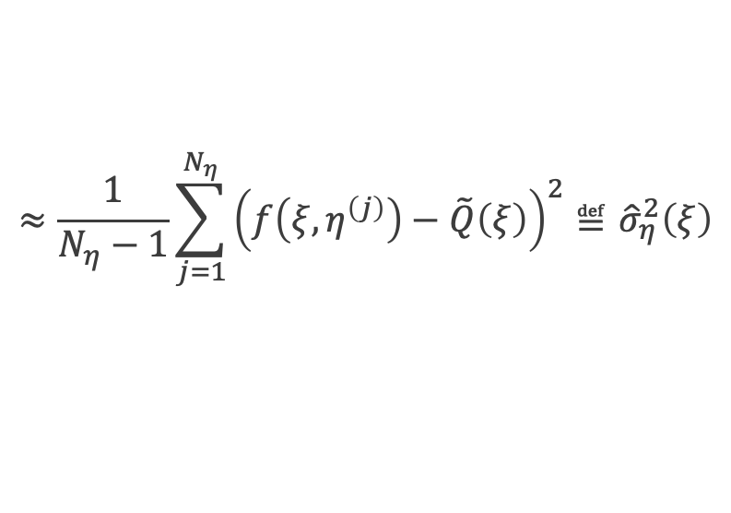
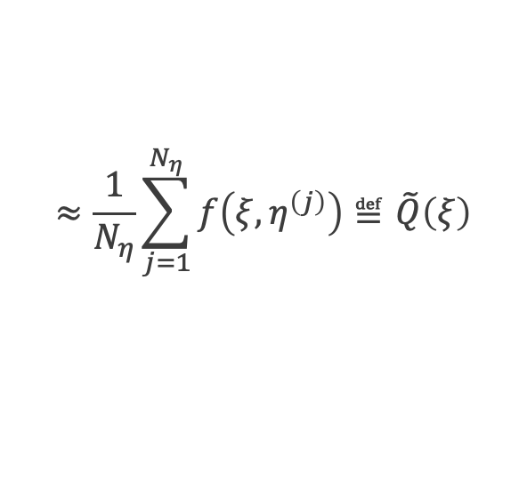
Background – stochastic solvers
Solver uncertainty $η$
Solver tally $f\left(η\right)$
$$≈\frac{1}{N_{η}}\sum_{j=1}^{N_{η}}{f\left(ξ,η^{\left(j\right)}\right)}≝\tilde{Q}\left(ξ\right)$$
$$Q\left(ξ\right)= 𝔼_{η}\left[f\left(ξ,η\right)\right]$$
$$≈\frac{1}{N_{η}−1}\sum_{j=1}^{N_{η}}{{\left(f\left(ξ,η^{\left(j\right)}\right)−\tilde{Q}\left(ξ\right)\right)}^{2}}≝{\hat{σ}}_{η}^{2}\left(ξ\right)$$
$$σ_{η}^{2}\left(ξ\right)= {𝕍ar}_{η}\left[f\left(ξ,η\right)\right]$$

Slide 21
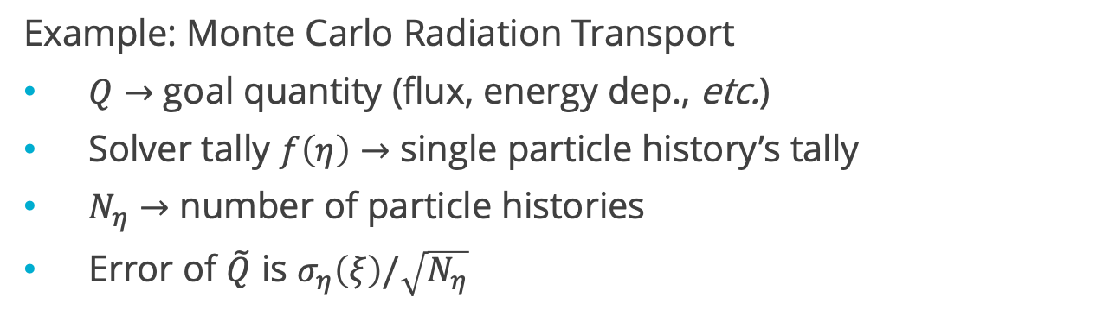
Background – stochastic solvers
Solver uncertainty $η$
Solver tally $f\left(η\right)$
$$≈\frac{1}{N_{η}}\sum_{j=1}^{N_{η}}{f\left(ξ,η^{\left(j\right)}\right)}≝\tilde{Q}\left(ξ\right)$$
$$Q\left(ξ\right)= 𝔼_{η}\left[f\left(ξ,η\right)\right]$$
$$≈\frac{1}{N_{η}−1}\sum_{j=1}^{N_{η}}{{\left(f\left(ξ,η^{\left(j\right)}\right)−\tilde{Q}\left(ξ\right)\right)}^{2}}≝{\hat{σ}}_{η}^{2}\left(ξ\right)$$
$$σ_{η}^{2}\left(ξ\right)= {𝕍ar}_{η}\left[f\left(ξ,η\right)\right]$$
Example: Monte Carlo Radiation Transport
$Q→$ goal quantity (flux, energy dep., etc.)
Solver tally $f\left(η\right)→$ single particle history’s tally
$N_{η}→$ number of particle histories
Error of $\tilde{Q}$ is $σ_{η}\left(ξ\right)/\sqrt{N_{η}}$

Slide 22

Background – stochastic solvers
Solver uncertainty $η$
Solver tally $f\left(η\right)$
$$≈\frac{1}{N_{η}}\sum_{j=1}^{N_{η}}{f\left(ξ,η^{\left(j\right)}\right)}≝\tilde{Q}\left(ξ\right)$$
$$Q\left(ξ\right)= 𝔼_{η}\left[f\left(ξ,η\right)\right]$$
Inaccessible
$$≈\frac{1}{N_{η}−1}\sum_{j=1}^{N_{η}}{{\left(f\left(ξ,η^{\left(j\right)}\right)−\tilde{Q}\left(ξ\right)\right)}^{2}}≝{\hat{σ}}_{η}^{2}\left(ξ\right)$$
$$σ_{η}^{2}\left(ξ\right)= {𝕍ar}_{η}\left[f\left(ξ,η\right)\right]$$
Example: Monte Carlo Radiation Transport
$Q→$ goal quantity (flux, energy dep., etc.)
Solver tally $f\left(η\right)→$ single particle history’s tally
$N_{η}→$ number of particle histories
Error of $\tilde{Q}$ is $σ_{η}\left(ξ\right)/\sqrt{N_{η}}$

Slide 23

Background – stochastic solvers
Solver uncertainty $η$
Solver tally $f\left(η\right)$
$$≈\frac{1}{N_{η}}\sum_{j=1}^{N_{η}}{f\left(ξ,η^{\left(j\right)}\right)}≝\tilde{Q}\left(ξ\right)$$
$$Q\left(ξ\right)= 𝔼_{η}\left[f\left(ξ,η\right)\right]$$
Inaccessible
$$≈\frac{1}{N_{η}−1}\sum_{j=1}^{N_{η}}{{\left(f\left(ξ,η^{\left(j\right)}\right)−\tilde{Q}\left(ξ\right)\right)}^{2}}≝{\hat{σ}}_{η}^{2}\left(ξ\right)$$
$$σ_{η}^{2}\left(ξ\right)= {𝕍ar}_{η}\left[f\left(ξ,η\right)\right]$$
Example: Monte Carlo Radiation Transport
$Q→$ goal quantity (flux, energy dep., etc.)
Solver tally $f\left(η\right)→$ single particle history’s tally
$N_{η}→$ number of particle histories
Error of $\tilde{Q}$ is $σ_{η}\left(ξ\right)/\sqrt{N_{η}}$

Slide 24

Saltelli method with stochastic solvers
Sampling-based estimation for $S_{i}$ and $T_{i}$ with stochastic solvers
Given $Q=Q\left(ξ_{1}, ξ_{2}, …, ξ_{d}\right)$, generate a $\left(N_{ξ},2d\right)$ matrix of independent input samples and define matrices $A$ and $B$, each containing half of the sample
$$A=\left[\begin{matrix}ξ_{1}^{\left(1\right)} & … & ξ_{i}^{\left(1\right)} & … & ξ_{d}^{\left(1\right)} \\ ⋮ & & ⋱ & & ⋮ \\ ξ_{1}^{\left(N_{ξ}\right)} & … & ξ_{i}^{\left(N_{ξ}\right)} & … & ξ_{d}^{\left(N_{ξ}\right)}\end{matrix}\right], B=\left[\begin{matrix}ξ_{d+1}^{\left(1\right)} & … & ξ_{d+i}^{\left(1\right)} & … & ξ_{2d}^{\left(1\right)} \\ ⋮ & & ⋱ & & ⋮ \\ ξ_{d+1}^{\left(N_{ξ}\right)} & … & ξ_{d+i}^{\left(N_{ξ}\right)} & … & ξ_{2d}^{\left(N_{ξ}\right)}\end{matrix}\right]$$
For all $d$inputs, create matrix $C_{i}$ using all columns of $B$ except the $i$th column, which is from $A$
$$C_{i}=\left[\begin{matrix}ξ_{d+1}^{\left(1\right)} & … & ξ_{i}^{\left(1\right)} & … & ξ_{2d}^{\left(1\right)} \\ ⋮ & & ⋱ & & ⋮ \\ ξ_{d+1}^{\left(N_{ξ}\right)} & … & ξ_{i}^{\left(N_{ξ}\right)} & … & ξ_{2d}^{\left(N_{ξ}\right)}\end{matrix}\right]$$
Compute model output vector $\tilde{y}$ of dimension $\left(N_{ξ},1\right)$ for $A$, $B$, and all $C_{i}$
$${\tilde{y}}_{A}=\left[\begin{matrix}\tilde{Q}\left(ξ_{1}^{(1)},…,ξ_{i}^{\left(1\right)},…,ξ_{d}^{(1)}\right) \\ ⋮ \\ \tilde{Q}\left(ξ_{1}^{(N_{ξ})},…,ξ_{i}^{\left(N_{ξ}\right)},…,ξ_{d}^{(N_{ξ})}\right)\end{matrix}\right]$$

Slide 25
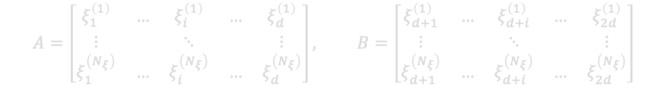

Saltelli method with stochastic solvers
Sampling-based estimation for $S_{i}$ and $T_{i}$ with stochastic solvers
Given $Q=Q\left(ξ_{1}, ξ_{2}, …, ξ_{d}\right)$, generate a $\left(N_{ξ},2d\right)$ matrix of independent input samples and define matrices $A$ and $B$, each containing half of the sample
$$A=\left[\begin{matrix}ξ_{1}^{\left(1\right)} & … & ξ_{i}^{\left(1\right)} & … & ξ_{d}^{\left(1\right)} \\ ⋮ & & ⋱ & & ⋮ \\ ξ_{1}^{\left(N_{ξ}\right)} & … & ξ_{i}^{\left(N_{ξ}\right)} & … & ξ_{d}^{\left(N_{ξ}\right)}\end{matrix}\right], B=\left[\begin{matrix}ξ_{d+1}^{\left(1\right)} & … & ξ_{d+i}^{\left(1\right)} & … & ξ_{2d}^{\left(1\right)} \\ ⋮ & & ⋱ & & ⋮ \\ ξ_{d+1}^{\left(N_{ξ}\right)} & … & ξ_{d+i}^{\left(N_{ξ}\right)} & … & ξ_{2d}^{\left(N_{ξ}\right)}\end{matrix}\right]$$
For all $d$inputs, create matrix $C_{i}$ using all columns of $B$ except the $i$th column, which is from $A$
$$C_{i}=\left[\begin{matrix}ξ_{d+1}^{\left(1\right)} & … & ξ_{i}^{\left(1\right)} & … & ξ_{2d}^{\left(1\right)} \\ ⋮ & & ⋱ & & ⋮ \\ ξ_{d+1}^{\left(N_{ξ}\right)} & … & ξ_{i}^{\left(N_{ξ}\right)} & … & ξ_{2d}^{\left(N_{ξ}\right)}\end{matrix}\right]$$
Compute model output vector $\tilde{y}$ of dimension $\left(N_{ξ},1\right)$ for $A$, $B$, and all $C_{i}$
$${\tilde{y}}_{A}=\left[\begin{matrix}\tilde{Q}\left(ξ_{1}^{(1)},…,ξ_{i}^{\left(1\right)},…,ξ_{d}^{(1)}\right) \\ ⋮ \\ \tilde{Q}\left(ξ_{1}^{(N_{ξ})},…,ξ_{i}^{\left(N_{ξ}\right)},…,ξ_{d}^{(N_{ξ})}\right)\end{matrix}\right]$$

Slide 26

Saltelli method with stochastic solvers
Sampling-based estimation for $S_{i}$ and $T_{i}$ with stochastic solvers
Given $Q=Q\left(ξ_{1}, ξ_{2}, …, ξ_{d}\right)$, generate a $\left(N_{ξ},2d\right)$ matrix of independent input samples and define matrices $A$ and $B$, each containing half of the sample
$$A=\left[\begin{matrix}ξ_{1}^{\left(1\right)} & … & ξ_{i}^{\left(1\right)} & … & ξ_{d}^{\left(1\right)} \\ ⋮ & & ⋱ & & ⋮ \\ ξ_{1}^{\left(N_{ξ}\right)} & … & ξ_{i}^{\left(N_{ξ}\right)} & … & ξ_{d}^{\left(N_{ξ}\right)}\end{matrix}\right], B=\left[\begin{matrix}ξ_{d+1}^{\left(1\right)} & … & ξ_{d+i}^{\left(1\right)} & … & ξ_{2d}^{\left(1\right)} \\ ⋮ & & ⋱ & & ⋮ \\ ξ_{d+1}^{\left(N_{ξ}\right)} & … & ξ_{d+i}^{\left(N_{ξ}\right)} & … & ξ_{2d}^{\left(N_{ξ}\right)}\end{matrix}\right]$$
For all $d$inputs, create matrix $C_{i}$ using all columns of $B$ except the $i$th column, which is from $A$
$$C_{i}=\left[\begin{matrix}ξ_{d+1}^{\left(1\right)} & … & ξ_{i}^{\left(1\right)} & … & ξ_{2d}^{\left(1\right)} \\ ⋮ & & ⋱ & & ⋮ \\ ξ_{d+1}^{\left(N_{ξ}\right)} & … & ξ_{i}^{\left(N_{ξ}\right)} & … & ξ_{2d}^{\left(N_{ξ}\right)}\end{matrix}\right]$$
Compute model output vector $\tilde{y}$ of dimension $\left(N_{ξ},1\right)$ for $A$, $B$, and all $C_{i}$
$${\tilde{y}}_{A}=\left[\begin{matrix}\tilde{Q}\left(ξ_{1}^{(1)},…,ξ_{i}^{\left(1\right)},…,ξ_{d}^{(1)}\right) \\ ⋮ \\ \tilde{Q}\left(ξ_{1}^{(N_{ξ})},…,ξ_{i}^{\left(N_{ξ}\right)},…,ξ_{d}^{(N_{ξ})}\right)\end{matrix}\right]$$
Monte Carlo radiation transport simulation with $N_{η}$ particle histories each

Slide 27
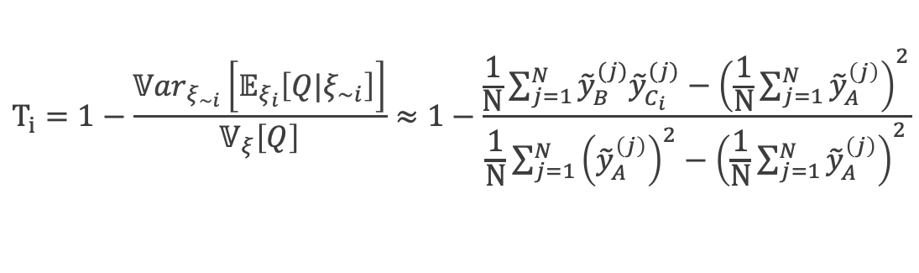
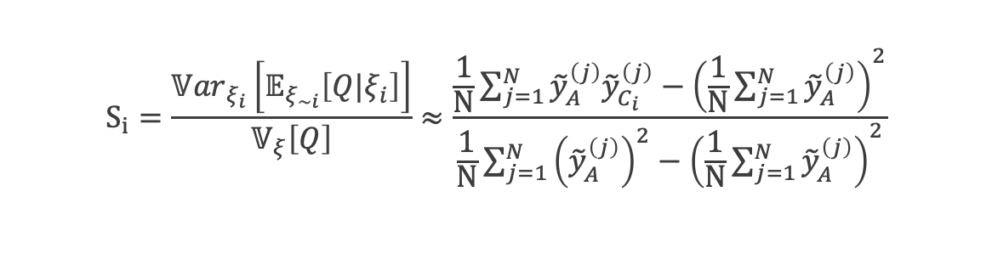
Saltelli method with stochastic solvers
Sampling-based estimation for $S_{i}$ and $T_{i}$ with stochastic solvers
Use sampling estimators to estimate first-order and total SIs [1]
$$S_{i}=\frac{{𝕍ar}_{ξ_{i}}\left[𝔼_{ξ_{∼i}}\left[Q|ξ_{i}\right]\right]}{𝕍_{ξ}\left[Q\right]}≈\frac{\frac{1}{N}\sum_{j=1}^{N}{{\tilde{y}}_{A}^{\left(j\right)}{\tilde{y}}_{C_{i}}^{\left(j\right)}}−{\left(\frac{1}{N}\sum_{j=1}^{N}{{\tilde{y}}_{A}^{\left(j\right)}}\right)}^{2}}{\frac{1}{N}\sum_{j=1}^{N}{{\left({\tilde{y}}_{A}^{\left(j\right)}\right)}^{2}}−{\left(\frac{1}{N}\sum_{j=1}^{N}{{\tilde{y}}_{A}^{\left(j\right)}}\right)}^{2}}$$
$$T_{i}=1−\frac{{𝕍ar}_{ξ_{\sim i}}\left[𝔼_{ξ_{i}}\left[Q|ξ_{∼i}\right]\right]}{𝕍_{ξ}\left[Q\right]}≈1−\frac{\frac{1}{N}\sum_{j=1}^{N}{{\tilde{y}}_{B}^{(j)}{\tilde{y}}_{C_{i}}^{(j)}}−{\left(\frac{1}{N}\sum_{j=1}^{N}{{\tilde{y}}_{A}^{\left(j\right)}}\right)}^{2}}{\frac{1}{N}\sum_{j=1}^{N}{{\left({\tilde{y}}_{A}^{\left(j\right)}\right)}^{2}}−{\left(\frac{1}{N}\sum_{j=1}^{N}{{\tilde{y}}_{A}^{\left(j\right)}}\right)}^{2}}$$

Slide 28
Saltelli method with stochastic solvers
Sampling-based estimation for $S_{i}$ and $T_{i}$ with stochastic solvers
Use sampling estimators to estimate first-order and total SIs [1]
$$S_{i}=\frac{{𝕍ar}_{ξ_{i}}\left[𝔼_{ξ_{∼i}}\left[Q|ξ_{i}\right]\right]}{𝕍_{ξ}\left[Q\right]}≈\frac{\frac{1}{N}\sum_{j=1}^{N}{{\tilde{y}}_{A}^{\left(j\right)}{\tilde{y}}_{C_{i}}^{\left(j\right)}}−{\left(\frac{1}{N}\sum_{j=1}^{N}{{\tilde{y}}_{A}^{\left(j\right)}}\right)}^{2}}{\frac{1}{N}\sum_{j=1}^{N}{{\left({\tilde{y}}_{A}^{\left(j\right)}\right)}^{2}}−{\left(\frac{1}{N}\sum_{j=1}^{N}{{\tilde{y}}_{A}^{\left(j\right)}}\right)}^{2}}$$
$$T_{i}=1−\frac{{𝕍ar}_{ξ_{\sim i}}\left[𝔼_{ξ_{i}}\left[Q|ξ_{∼i}\right]\right]}{𝕍_{ξ}\left[Q\right]}≈1−\frac{\frac{1}{N}\sum_{j=1}^{N}{{\tilde{y}}_{B}^{(j)}{\tilde{y}}_{C_{i}}^{(j)}}−{\left(\frac{1}{N}\sum_{j=1}^{N}{{\tilde{y}}_{A}^{\left(j\right)}}\right)}^{2}}{\frac{1}{N}\sum_{j=1}^{N}{{\left({\tilde{y}}_{A}^{\left(j\right)}\right)}^{2}}−{\left(\frac{1}{N}\sum_{j=1}^{N}{{\tilde{y}}_{A}^{\left(j\right)}}\right)}^{2}}$$

Slide 29
variance deconvolution
Law of total variance $𝕍ar\left[\tilde{Q}\right]={𝕍ar}_{ξ}\left[𝔼_{η}\left[\tilde{Q}\right]\right]+𝔼_{ξ}\left[{𝕍ar}_{η}\left[\tilde{Q}\right]\right]$

Slide 30
variance deconvolution
Law of total variance $𝕍ar\left[\tilde{Q}\right]={𝕍ar}_{ξ}\left[𝔼_{η}\left[\tilde{Q}\right]\right]+𝔼_{ξ}\left[{𝕍ar}_{η}\left[\tilde{Q}\right]\right]$
$𝕍ar_{ξ}\left[Q\right]$ with variance deconvolution [2]

Slide 31
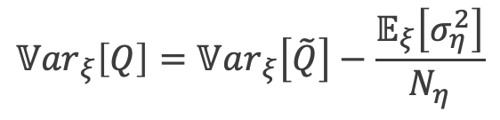
variance deconvolution
Law of total variance $𝕍ar\left[\tilde{Q}\right]={𝕍ar}_{ξ}\left[𝔼_{η}\left[\tilde{Q}\right]\right]+𝔼_{ξ}\left[{𝕍ar}_{η}\left[\tilde{Q}\right]\right]$
$𝕍ar_{ξ}\left[Q\right]$ with variance deconvolution [2]
Total variance
Average MC RT solver variance
$${𝕍ar}_{ξ}\left[Q\right]=𝕍ar_{ξ}\left[\tilde{Q}\right]−\frac{𝔼_{ξ}\left[σ_{η}^{2}\right]}{N_{η}}$$
Goal:
Parametric variance

Slide 32
variance deconvolution
Law of total variance $𝕍ar\left[\tilde{Q}\right]={𝕍ar}_{ξ}\left[𝔼_{η}\left[\tilde{Q}\right]\right]+𝔼_{ξ}\left[{𝕍ar}_{η}\left[\tilde{Q}\right]\right]$
Accessible:
$𝕍ar_{ξ}\left[Q\right]$ with variance deconvolution [2]
Total variance
Average MC RT solver variance
$${𝕍ar}_{ξ}\left[Q\right]=𝕍ar_{ξ}\left[\tilde{Q}\right]−\frac{𝔼_{ξ}\left[σ_{η}^{2}\right]}{N_{η}}$$
Goal:
Parametric variance

Slide 33
variance deconvolution
Law of total variance $𝕍ar\left[\tilde{Q}\right]={𝕍ar}_{ξ}\left[𝔼_{η}\left[\tilde{Q}\right]\right]+𝔼_{ξ}\left[{𝕍ar}_{η}\left[\tilde{Q}\right]\right]$
Accessible:
$𝕍ar_{ξ}\left[Q\right]$ with variance deconvolution [2]
Total variance
Average MC RT solver variance
$${𝕍ar}_{ξ}\left[Q\right]=𝕍ar_{ξ}\left[\tilde{Q}\right]−\frac{𝔼_{ξ}\left[σ_{η}^{2}\right]}{N_{η}}$$
Goal:
Parametric variance
First-order effects with variance deconvolution
$$𝕍_{i}={𝕍ar}_{ξ_{i}}\left[𝔼_{ξ_{∼i}}\left[Q\right]\right]=𝕍ar_{ξ}\left[\tilde{Q}\right]−𝔼_{ξ_{i}}\left[{𝕍ar}_{ξ_{∼i}}\left[\tilde{Q}\right]\right]$$
Goal:
First-order effect
$$𝕍_{∼i}={𝕍ar}_{ξ_{∼i}}\left[𝔼_{ξ_{i}}\left[Q\right]\right]=𝕍ar_{ξ}\left[\tilde{Q}\right]−𝔼_{ξ_{∼i}}\left[{𝕍ar}_{ξ_{i}}\left[\tilde{Q}\right]\right]$$

Slide 34
variance deconvolution
Law of total variance $𝕍ar\left[\tilde{Q}\right]={𝕍ar}_{ξ}\left[𝔼_{η}\left[\tilde{Q}\right]\right]+𝔼_{ξ}\left[{𝕍ar}_{η}\left[\tilde{Q}\right]\right]$
Accessible:
$𝕍ar_{ξ}\left[Q\right]$ with variance deconvolution [2]
Total variance
Average MC RT solver variance
$${𝕍ar}_{ξ}\left[Q\right]=𝕍ar_{ξ}\left[\tilde{Q}\right]−\frac{𝔼_{ξ}\left[σ_{η}^{2}\right]}{N_{η}}$$
Goal:
Parametric variance
Accessible:
First-order effects with variance deconvolution
Total variance
Polluted conditional mean
$$𝕍_{i}={𝕍ar}_{ξ_{i}}\left[𝔼_{ξ_{∼i}}\left[Q\right]\right]=𝕍ar_{ξ}\left[\tilde{Q}\right]−𝔼_{ξ_{i}}\left[{𝕍ar}_{ξ_{∼i}}\left[\tilde{Q}\right]\right]$$
Goal:
First-order effect
$$𝕍_{∼i}={𝕍ar}_{ξ_{∼i}}\left[𝔼_{ξ_{i}}\left[Q\right]\right]=𝕍ar_{ξ}\left[\tilde{Q}\right]−𝔼_{ξ_{∼i}}\left[{𝕍ar}_{ξ_{i}}\left[\tilde{Q}\right]\right]$$

Slide 35

Modified saltelli method
Sampling estimators
$$S_{i}=\frac{𝕍ar_{ξ}\left[\tilde{Q}\right]−𝔼_{ξ_{i}}\left[{𝕍ar}_{ξ_{∼i}}\left[\tilde{Q}\right]\right]}{𝕍_{ξ}\left[Q\right]}$$
Notes:
https://arxiv.org/ftp/arxiv/papers/2203/2203.00639.pdf
S_i =
“Fractional reduction in V[Q] which would be obtained on average if xi_i could be fixed.”
“Fraction of variance that would remain on average if one received perfect information on all other factors”

Slide 36

Modified saltelli method
Sampling estimators
$$S_{i}=\frac{𝕍ar_{ξ}\left[\tilde{Q}\right]−𝔼_{ξ_{i}}\left[{𝕍ar}_{ξ_{∼i}}\left[\tilde{Q}\right]\right]}{𝕍_{ξ}\left[Q\right]}$$
Notes:
https://arxiv.org/ftp/arxiv/papers/2203/2203.00639.pdf
S_i =
“Fractional reduction in V[Q] which would be obtained on average if xi_i could be fixed.”
“Fraction of variance that would remain on average if one received perfect information on all other factors”

Slide 37
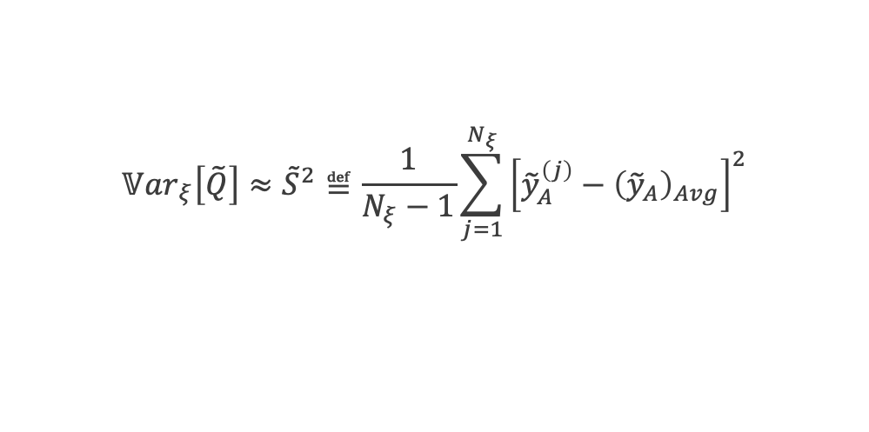
Modified saltelli method
Sampling estimators
$$S_{i}=\frac{𝕍ar_{ξ}\left[\tilde{Q}\right]−𝔼_{ξ_{i}}\left[{𝕍ar}_{ξ_{∼i}}\left[\tilde{Q}\right]\right]}{𝕍_{ξ}\left[Q\right]}$$
$$𝕍ar_{ξ}\left[\tilde{Q}\right]≈{\tilde{S}}^{2}≝\frac{1}{N_{ξ}−1}\sum_{j=1}^{N_{ξ}}{{\left[{\tilde{y}}_{A}^{\left(j\right)}−{\left({\tilde{y}}_{A}\right)}_{Avg}\right]}^{2}}$$
Notes:
https://arxiv.org/ftp/arxiv/papers/2203/2203.00639.pdf
S_i =
“Fractional reduction in V[Q] which would be obtained on average if xi_i could be fixed.”
“Fraction of variance that would remain on average if one received perfect information on all other factors”

Slide 38

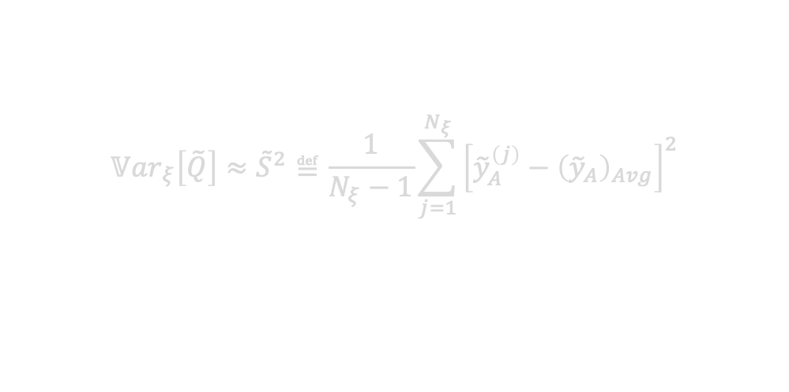
Modified saltelli method
Sampling estimators
$$S_{i}=\frac{𝕍ar_{ξ}\left[\tilde{Q}\right]−𝔼_{ξ_{i}}\left[{𝕍ar}_{ξ_{∼i}}\left[\tilde{Q}\right]\right]}{𝕍_{ξ}\left[Q\right]}$$
$$𝕍ar_{ξ}\left[\tilde{Q}\right]≈{\tilde{S}}^{2}≝\frac{1}{N_{ξ}−1}\sum_{j=1}^{N_{ξ}}{{\left[{\tilde{y}}_{A}^{\left(j\right)}−{\left({\tilde{y}}_{A}\right)}_{Avg}\right]}^{2}}$$
Notes:
https://arxiv.org/ftp/arxiv/papers/2203/2203.00639.pdf
S_i =
“Fractional reduction in V[Q] which would be obtained on average if xi_i could be fixed.”
“Fraction of variance that would remain on average if one received perfect information on all other factors”

Slide 39
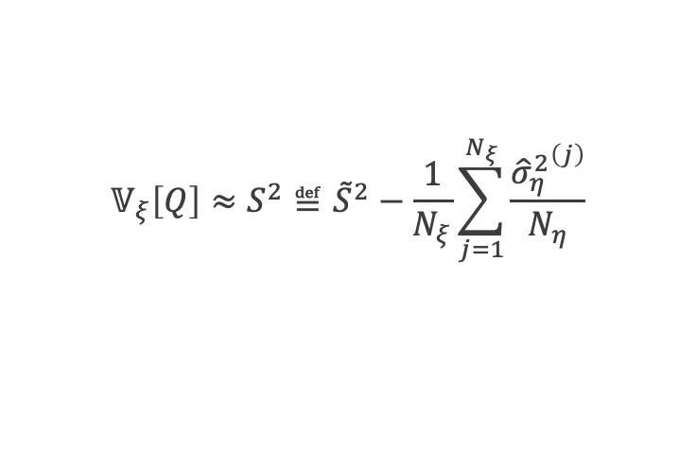
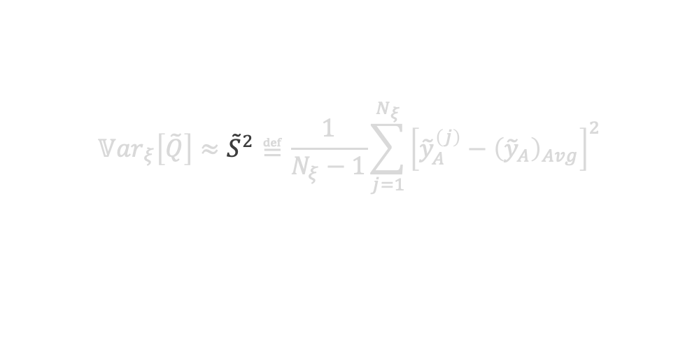
Modified saltelli method
Sampling estimators
$$S_{i}=\frac{𝕍ar_{ξ}\left[\tilde{Q}\right]−𝔼_{ξ_{i}}\left[{𝕍ar}_{ξ_{∼i}}\left[\tilde{Q}\right]\right]}{𝕍_{ξ}\left[Q\right]}$$
$$𝕍ar_{ξ}\left[\tilde{Q}\right]≈{\tilde{S}}^{2}≝\frac{1}{N_{ξ}−1}\sum_{j=1}^{N_{ξ}}{{\left[{\tilde{y}}_{A}^{\left(j\right)}−{\left({\tilde{y}}_{A}\right)}_{Avg}\right]}^{2}}$$
$$𝕍_{ξ}\left[Q\right]≈S^{2}≝{\tilde{S}}^{2}−\frac{1}{N_{ξ}}\sum_{j=1}^{N_{ξ}}{\frac{{{\hat{σ}}_{η}^{2}}^{\left(j\right)}}{N_{η}}}$$
Notes:
https://arxiv.org/ftp/arxiv/papers/2203/2203.00639.pdf
S_i =
“Fractional reduction in V[Q] which would be obtained on average if xi_i could be fixed.”
“Fraction of variance that would remain on average if one received perfect information on all other factors”

Slide 40

Modified saltelli method
Sampling estimators
$$S_{i}=\frac{𝕍ar_{ξ}\left[\tilde{Q}\right]−𝔼_{ξ_{i}}\left[{𝕍ar}_{ξ_{∼i}}\left[\tilde{Q}\right]\right]}{𝕍_{ξ}\left[Q\right]}$$
Notes:
https://arxiv.org/ftp/arxiv/papers/2203/2203.00639.pdf
S_i =
“Fractional reduction in V[Q] which would be obtained on average if xi_i could be fixed.”
“Fraction of variance that would remain on average if one received perfect information on all other factors”

Slide 41
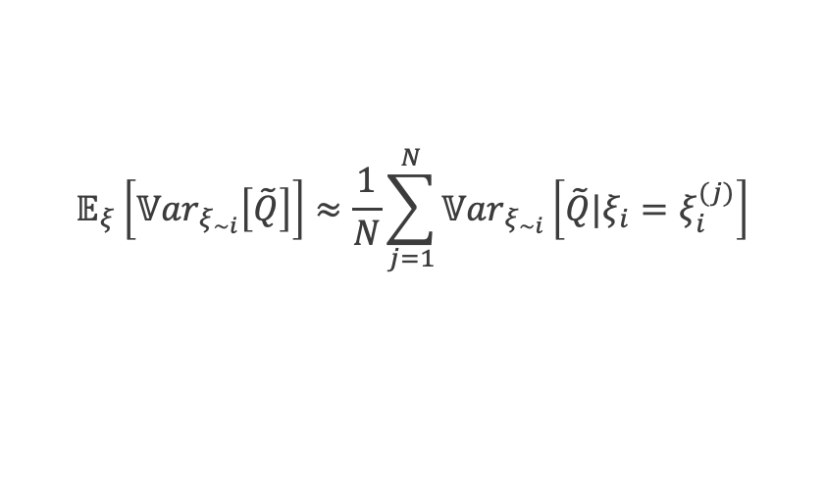
Modified saltelli method
Sampling estimators
$$S_{i}=\frac{𝕍ar_{ξ}\left[\tilde{Q}\right]−𝔼_{ξ_{i}}\left[{𝕍ar}_{ξ_{∼i}}\left[\tilde{Q}\right]\right]}{𝕍_{ξ}\left[Q\right]}$$
$$𝔼_{ξ}\left[{𝕍ar}_{ξ_{∼i}}\left[\tilde{Q}\right]\right]≈\frac{1}{N}\sum_{j=1}^{N}{{𝕍ar}_{ξ_{∼i}}\left[\tilde{Q}|ξ_{i}=ξ_{i}^{(j)}\right]}$$
Notes:
https://arxiv.org/ftp/arxiv/papers/2203/2203.00639.pdf
S_i =
“Fractional reduction in V[Q] which would be obtained on average if xi_i could be fixed.”
“Fraction of variance that would remain on average if one received perfect information on all other factors”

Slide 42
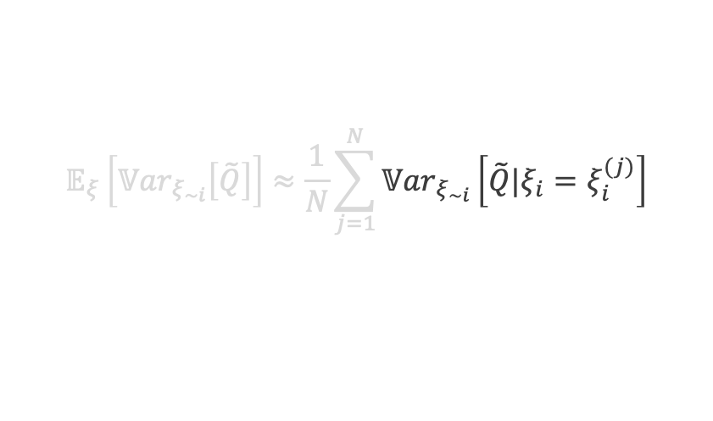
Modified saltelli method
Sampling estimators
$$S_{i}=\frac{𝕍ar_{ξ}\left[\tilde{Q}\right]−𝔼_{ξ_{i}}\left[{𝕍ar}_{ξ_{∼i}}\left[\tilde{Q}\right]\right]}{𝕍_{ξ}\left[Q\right]}$$
$$𝔼_{ξ}\left[{𝕍ar}_{ξ_{∼i}}\left[\tilde{Q}\right]\right]≈\frac{1}{N}\sum_{j=1}^{N}{{𝕍ar}_{ξ_{∼i}}\left[\tilde{Q}|ξ_{i}=ξ_{i}^{(j)}\right]}$$
Notes:
https://arxiv.org/ftp/arxiv/papers/2203/2203.00639.pdf
S_i =
“Fractional reduction in V[Q] which would be obtained on average if xi_i could be fixed.”
“Fraction of variance that would remain on average if one received perfect information on all other factors”

Slide 43
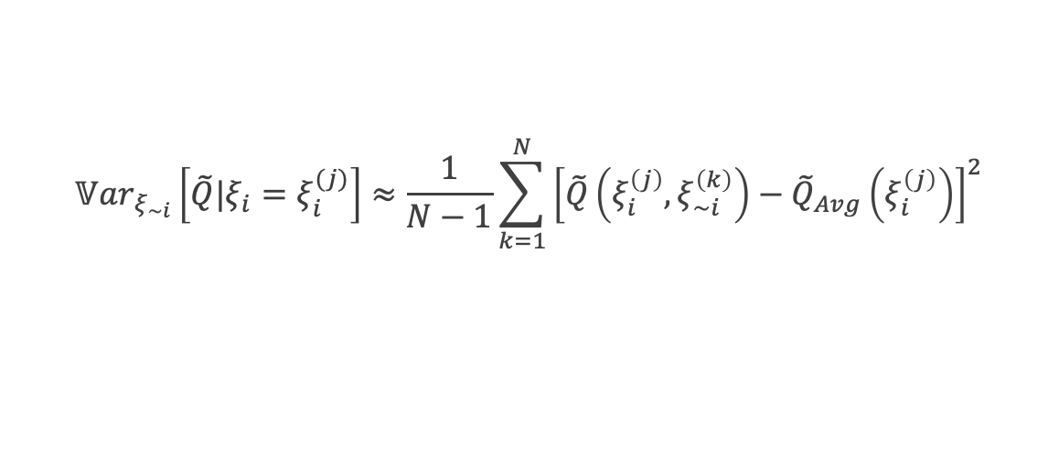
Modified saltelli method
Sampling estimators
$$S_{i}=\frac{𝕍ar_{ξ}\left[\tilde{Q}\right]−𝔼_{ξ_{i}}\left[{𝕍ar}_{ξ_{∼i}}\left[\tilde{Q}\right]\right]}{𝕍_{ξ}\left[Q\right]}$$
$$𝔼_{ξ}\left[{𝕍ar}_{ξ_{∼i}}\left[\tilde{Q}\right]\right]≈\frac{1}{N}\sum_{j=1}^{N}{{𝕍ar}_{ξ_{∼i}}\left[\tilde{Q}|ξ_{i}=ξ_{i}^{(j)}\right]}$$
$${𝕍ar}_{ξ_{∼i}}\left[\tilde{Q}|ξ_{i}=ξ_{i}^{(j)}\right]≈\frac{1}{N−1}\sum_{k=1}^{N}{{\left[\tilde{Q}\left(ξ_{i}^{\left(j\right)},ξ_{∼i}^{\left(k\right)}\right)−{\tilde{Q}}_{Avg}\left(ξ_{i}^{\left(j\right)}\right)\right]}^{2}}$$
Notes:
https://arxiv.org/ftp/arxiv/papers/2203/2203.00639.pdf
S_i =
“Fractional reduction in V[Q] which would be obtained on average if xi_i could be fixed.”
“Fraction of variance that would remain on average if one received perfect information on all other factors”

Slide 44
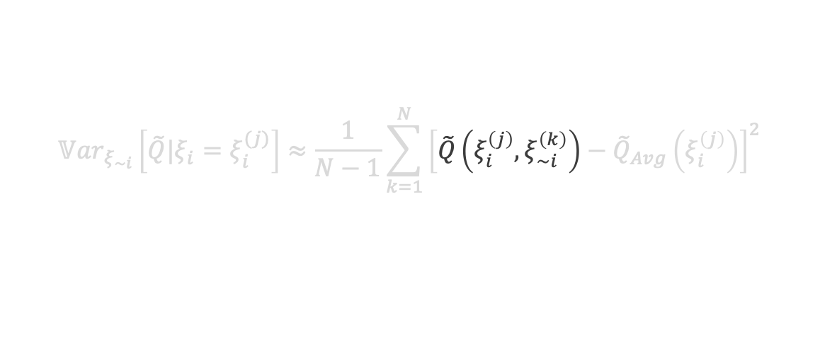
Modified saltelli method
Sampling estimators
$$S_{i}=\frac{𝕍ar_{ξ}\left[\tilde{Q}\right]−𝔼_{ξ_{i}}\left[{𝕍ar}_{ξ_{∼i}}\left[\tilde{Q}\right]\right]}{𝕍_{ξ}\left[Q\right]}$$
$$𝔼_{ξ}\left[{𝕍ar}_{ξ_{∼i}}\left[\tilde{Q}\right]\right]≈\frac{1}{N}\sum_{j=1}^{N}{{𝕍ar}_{ξ_{∼i}}\left[\tilde{Q}|ξ_{i}=ξ_{i}^{(j)}\right]}$$
$${𝕍ar}_{ξ_{∼i}}\left[\tilde{Q}|ξ_{i}=ξ_{i}^{(j)}\right]≈\frac{1}{N−1}\sum_{k=1}^{N}{{\left[\tilde{Q}\left(ξ_{i}^{\left(j\right)},ξ_{∼i}^{\left(k\right)}\right)−{\tilde{Q}}_{Avg}\left(ξ_{i}^{\left(j\right)}\right)\right]}^{2}}$$
Notes:
https://arxiv.org/ftp/arxiv/papers/2203/2203.00639.pdf
S_i =
“Fractional reduction in V[Q] which would be obtained on average if xi_i could be fixed.”
“Fraction of variance that would remain on average if one received perfect information on all other factors”

Slide 45
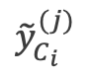
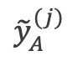
Modified saltelli method
Sampling estimators
$$S_{i}=\frac{𝕍ar_{ξ}\left[\tilde{Q}\right]−𝔼_{ξ_{i}}\left[{𝕍ar}_{ξ_{∼i}}\left[\tilde{Q}\right]\right]}{𝕍_{ξ}\left[Q\right]}$$
$$𝔼_{ξ}\left[{𝕍ar}_{ξ_{∼i}}\left[\tilde{Q}\right]\right]≈\frac{1}{N}\sum_{j=1}^{N}{{𝕍ar}_{ξ_{∼i}}\left[\tilde{Q}|ξ_{i}=ξ_{i}^{(j)}\right]}$$
$${𝕍ar}_{ξ_{∼i}}\left[\tilde{Q}|ξ_{i}=ξ_{i}^{(j)}\right]≈\frac{1}{N−1}\sum_{k=1}^{N}{{\left[\tilde{Q}\left(ξ_{i}^{\left(j\right)},ξ_{∼i}^{\left(k\right)}\right)−{\tilde{Q}}_{Avg}\left(ξ_{i}^{\left(j\right)}\right)\right]}^{2}}$$
$${\tilde{y}}_{A}^{(j)}$$
$${\tilde{y}}_{C_{i}}^{(j)}$$
Notes:
https://arxiv.org/ftp/arxiv/papers/2203/2203.00639.pdf
S_i =
“Fractional reduction in V[Q] which would be obtained on average if xi_i could be fixed.”
“Fraction of variance that would remain on average if one received perfect information on all other factors”

Slide 46
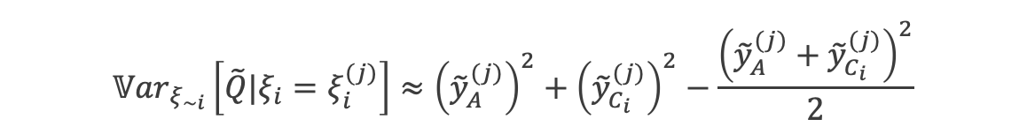
Modified saltelli method
Sampling estimators
$$S_{i}=\frac{𝕍ar_{ξ}\left[\tilde{Q}\right]−𝔼_{ξ_{i}}\left[{𝕍ar}_{ξ_{∼i}}\left[\tilde{Q}\right]\right]}{𝕍_{ξ}\left[Q\right]}$$
$$𝔼_{ξ}\left[{𝕍ar}_{ξ_{∼i}}\left[\tilde{Q}\right]\right]≈\frac{1}{N}\sum_{j=1}^{N}{{𝕍ar}_{ξ_{∼i}}\left[\tilde{Q}|ξ_{i}=ξ_{i}^{(j)}\right]}$$
$${𝕍ar}_{ξ_{∼i}}\left[\tilde{Q}|ξ_{i}=ξ_{i}^{(j)}\right]≈\frac{1}{N−1}\sum_{k=1}^{N}{{\left[\tilde{Q}\left(ξ_{i}^{\left(j\right)},ξ_{∼i}^{\left(k\right)}\right)−{\tilde{Q}}_{Avg}\left(ξ_{i}^{\left(j\right)}\right)\right]}^{2}}$$
$${\tilde{y}}_{A}^{(j)}$$
$${\tilde{y}}_{C_{i}}^{(j)}$$
$${𝕍ar}_{ξ_{∼i}}\left[\tilde{Q}|ξ_{i}=ξ_{i}^{(j)}\right]≈{\left({\tilde{y}}_{A}^{(j)}\right)}^{2}+{\left({\tilde{y}}_{C_{i}}^{(j)}\right)}^{2}−\frac{{\left({\tilde{y}}_{A}^{(j)}+{\tilde{y}}_{C_{i}}^{(j)}\right)}^{2}}{2}$$
Notes:
https://arxiv.org/ftp/arxiv/papers/2203/2203.00639.pdf
S_i =
“Fractional reduction in V[Q] which would be obtained on average if xi_i could be fixed.”
“Fraction of variance that would remain on average if one received perfect information on all other factors”

Slide 47
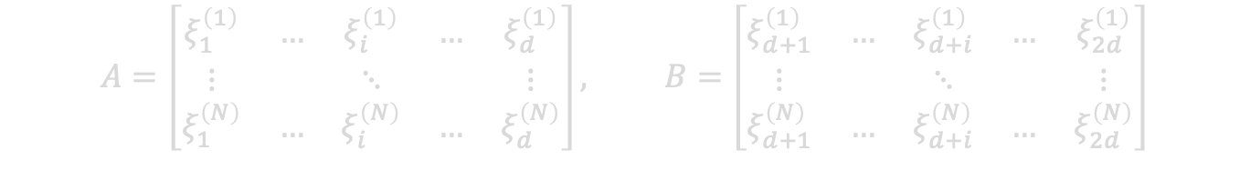


Modified Saltelli method
Sampling-based estimation for $S_{i}$ and $T_{i}$ with stochastic solvers
Given $Q=Q\left(ξ_{1}, ξ_{2}, …, ξ_{d}\right)$, generate a $\left(N,2d\right)$ matrix of independent input samples and define matrices $A$ and $B$, each containing half of the sample
$$A=\left[\begin{matrix}ξ_{1}^{\left(1\right)} & … & ξ_{i}^{\left(1\right)} & … & ξ_{d}^{\left(1\right)} \\ ⋮ & & ⋱ & & ⋮ \\ ξ_{1}^{\left(N\right)} & … & ξ_{i}^{\left(N\right)} & … & ξ_{d}^{\left(N\right)}\end{matrix}\right], B=\left[\begin{matrix}ξ_{d+1}^{\left(1\right)} & … & ξ_{d+i}^{\left(1\right)} & … & ξ_{2d}^{\left(1\right)} \\ ⋮ & & ⋱ & & ⋮ \\ ξ_{d+1}^{\left(N\right)} & … & ξ_{d+i}^{\left(N\right)} & … & ξ_{2d}^{\left(N\right)}\end{matrix}\right]$$
For all $d$inputs, create matrix $C_{i}$ using all columns of $B$ except the $i$th column, which is from $A$
$$C_{i}=\left[\begin{matrix}ξ_{d+1}^{\left(1\right)} & … & ξ_{i}^{\left(1\right)} & … & ξ_{2d}^{\left(1\right)} \\ ⋮ & & ⋱ & & ⋮ \\ ξ_{d+1}^{\left(N\right)} & … & ξ_{i}^{\left(N\right)} & … & ξ_{2d}^{\left(N\right)}\end{matrix}\right]$$
Compute model output vector$\tilde{y}$ of dimension $\left(N,1\right)$ for $A$, $B$, and all $C_{i}$ and vector of solver variances for $A$
$${\tilde{y}}_{A}=\left[\begin{matrix}\tilde{Q}\left(ξ_{1}^{(1)},…,ξ_{i}^{\left(1\right)},…,ξ_{d}^{(1)}\right) \\ ⋮ \\ \tilde{Q}\left(ξ_{1}^{(N)},…,ξ_{i}^{\left(N\right)},…,ξ_{d}^{(N)}\right)\end{matrix}\right], {\tilde{y}}_{σ_{η,A}^{2}}=\left[\begin{matrix}{\hat{σ}}_{η}^{2}\left(ξ^{(1)}\right) \\ ⋮ \\ {\hat{σ}}_{η}^{2}\left(ξ^{(N)}\right)\end{matrix}\right]$$

Slide 48

Modified Saltelli method
Sampling-based estimation for $S_{i}$ and $T_{i}$ with stochastic solvers
Given $Q=Q\left(ξ_{1}, ξ_{2}, …, ξ_{d}\right)$, generate a $\left(N,2d\right)$ matrix of independent input samples and define matrices $A$ and $B$, each containing half of the sample
$$A=\left[\begin{matrix}ξ_{1}^{\left(1\right)} & … & ξ_{i}^{\left(1\right)} & … & ξ_{d}^{\left(1\right)} \\ ⋮ & & ⋱ & & ⋮ \\ ξ_{1}^{\left(N\right)} & … & ξ_{i}^{\left(N\right)} & … & ξ_{d}^{\left(N\right)}\end{matrix}\right], B=\left[\begin{matrix}ξ_{d+1}^{\left(1\right)} & … & ξ_{d+i}^{\left(1\right)} & … & ξ_{2d}^{\left(1\right)} \\ ⋮ & & ⋱ & & ⋮ \\ ξ_{d+1}^{\left(N\right)} & … & ξ_{d+i}^{\left(N\right)} & … & ξ_{2d}^{\left(N\right)}\end{matrix}\right]$$
For all $d$inputs, create matrix $C_{i}$ using all columns of $B$ except the $i$th column, which is from $A$
$$C_{i}=\left[\begin{matrix}ξ_{d+1}^{\left(1\right)} & … & ξ_{i}^{\left(1\right)} & … & ξ_{2d}^{\left(1\right)} \\ ⋮ & & ⋱ & & ⋮ \\ ξ_{d+1}^{\left(N\right)} & … & ξ_{i}^{\left(N\right)} & … & ξ_{2d}^{\left(N\right)}\end{matrix}\right]$$
Compute model output vector$\tilde{y}$ of dimension $\left(N,1\right)$ for $A$, $B$, and all $C_{i}$ and vector of solver variances for $A$
$${\tilde{y}}_{A}=\left[\begin{matrix}\tilde{Q}\left(ξ_{1}^{(1)},…,ξ_{i}^{\left(1\right)},…,ξ_{d}^{(1)}\right) \\ ⋮ \\ \tilde{Q}\left(ξ_{1}^{(N)},…,ξ_{i}^{\left(N\right)},…,ξ_{d}^{(N)}\right)\end{matrix}\right], {\tilde{y}}_{σ_{η,A}^{2}}=\left[\begin{matrix}{\hat{σ}}_{η}^{2}\left(ξ^{(1)}\right) \\ ⋮ \\ {\hat{σ}}_{η}^{2}\left(ξ^{(N)}\right)\end{matrix}\right]$$

Slide 49

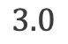
Radiation transport test problem
Problem definition
1D slab with three material regions
Neutral particle, steady-state, mono-energetic, attenuation-only
$$0$$
$$3.0$$

Slide 50
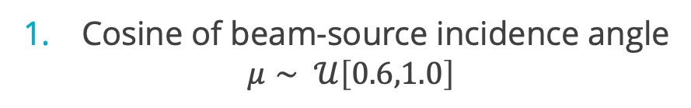
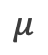
Radiation transport test problem
Problem definition
1D slab with three material regions
Neutral particle, steady-state, mono-energetic, attenuation-only
Uncertainty groups
Cosine of beam-source incidence angle
$$μ∼ 𝒰\left[0.6,1.0\right]$$
$$μ$$
$$0$$
$$3.0$$

Slide 51
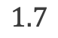
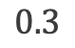
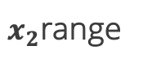
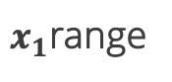
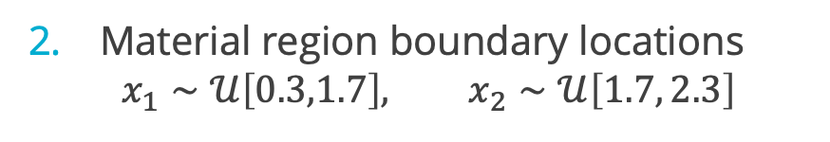
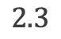
Radiation transport test problem
Problem definition
1D slab with three material regions
Neutral particle, steady-state, mono-energetic, attenuation-only
Uncertainty groups
Cosine of beam-source incidence angle
$$μ∼ 𝒰\left[0.6,1.0\right]$$
Material region boundary locations
$$x_{1}∼𝒰\left[0.3,1.7\right], x_{2}∼𝒰\left[1.7, 2.3\right]$$
$$μ$$
$$0$$
$$0.3$$
$$1.7$$
$$2.3$$
$$3.0$$
$x_{1}$range
$x_{2}$range

Slide 52
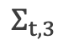
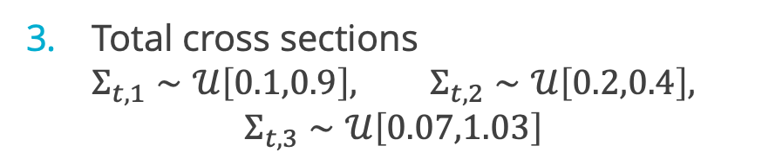

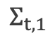
Radiation transport test problem
Problem definition
1D slab with three material regions
Neutral particle, steady-state, mono-energetic, attenuation-only
Uncertainty groups
Cosine of beam-source incidence angle
$$μ∼ 𝒰\left[0.6,1.0\right]$$
Material region boundary locations
$$x_{1}∼𝒰\left[0.3,1.7\right], x_{2}∼𝒰\left[1.7, 2.3\right]$$
$$Σ_{t,1}$$
$$Σ_{t,2}$$
$$Σ_{t,3}$$
Total cross sections
$$Σ_{t,1}∼𝒰\left[0.1,0.9\right], Σ_{t,2}∼𝒰\left[0.2,0.4\right],$$
$$Σ_{t,3}∼𝒰\left[0.07,1.03\right]$$
$$μ$$
$$0$$
$$0.3$$
$$1.7$$
$$2.3$$
$$3.0$$
$x_{1}$range
$x_{2}$range

Slide 53
Radiation transport test problem
Problem definition
1D slab with three material regions
Neutral particle, steady-state, mono-energetic, attenuation-only
Comparison
Benchmark: $N_{ξ}={10}^{8}$, analytic optical thickness Test: $N_{ξ}=1000$
Uncertainty groups
Cosine of beam-source incidence angle
$$μ∼ 𝒰\left[0.6,1.0\right]$$
Material region boundary locations
$$x_{1}∼𝒰\left[0.3,1.7\right], x_{2}∼𝒰\left[1.7, 2.3\right]$$
$$Σ_{t,1}$$
$$Σ_{t,2}$$
$$Σ_{t,3}$$
Total cross sections
$$Σ_{t,1}∼𝒰\left[0.1,0.9\right], Σ_{t,2}∼𝒰\left[0.2,0.4\right],$$
$$Σ_{t,3}∼𝒰\left[0.07,1.03\right]$$
$$μ$$
$$0$$
$$0.3$$
$$1.7$$
$$2.3$$
$$3.0$$
$x_{1}$range
$x_{2}$range

Slide 54
Radiation transport test problem
Problem definition
1D slab with three material regions
Neutral particle, steady-state, mono-energetic, attenuation-only
Comparison
Benchmark: $N_{ξ}={10}^{8}$, analytic optical thickness Test: $N_{ξ}=1000$
Straightforward Saltelli method vs. variance deconvolution modification
Uncertainty groups
Cosine of beam-source incidence angle
$$μ∼ 𝒰\left[0.6,1.0\right]$$
Material region boundary locations
$$x_{1}∼𝒰\left[0.3,1.7\right], x_{2}∼𝒰\left[1.7, 2.3\right]$$
$$Σ_{t,1}$$
$$Σ_{t,2}$$
$$Σ_{t,3}$$
Total cross sections
$$Σ_{t,1}∼𝒰\left[0.1,0.9\right], Σ_{t,2}∼𝒰\left[0.2,0.4\right],$$
$$Σ_{t,3}∼𝒰\left[0.07,1.03\right]$$
$$μ$$
$$0$$
$$0.3$$
$$1.7$$
$$2.3$$
$$3.0$$
$x_{1}$range
$x_{2}$range

Slide 55
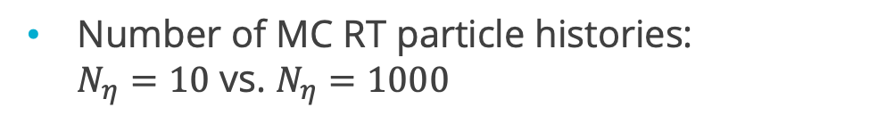
Radiation transport test problem
Problem definition
1D slab with three material regions
Neutral particle, steady-state, mono-energetic, attenuation-only
Comparison
Benchmark: $N_{ξ}={10}^{8}$, analytic optical thickness Test: $N_{ξ}=1000$
Straightforward Saltelli method vs. variance deconvolution modification
Uncertainty groups
Cosine of beam-source incidence angle
$$μ∼ 𝒰\left[0.6,1.0\right]$$
Number of MC RT particle histories: $N_{η}=10$ vs. $N_{η}=1000$
Material region boundary locations
$$x_{1}∼𝒰\left[0.3,1.7\right], x_{2}∼𝒰\left[1.7, 2.3\right]$$
$$Σ_{t,1}$$
$$Σ_{t,2}$$
$$Σ_{t,3}$$
Total cross sections
$$Σ_{t,1}∼𝒰\left[0.1,0.9\right], Σ_{t,2}∼𝒰\left[0.2,0.4\right],$$
$$Σ_{t,3}∼𝒰\left[0.07,1.03\right]$$
$$μ$$
$$0$$
$$0.3$$
$$1.7$$
$$2.3$$
$$3.0$$
$x_{1}$range
$x_{2}$range

Slide 56
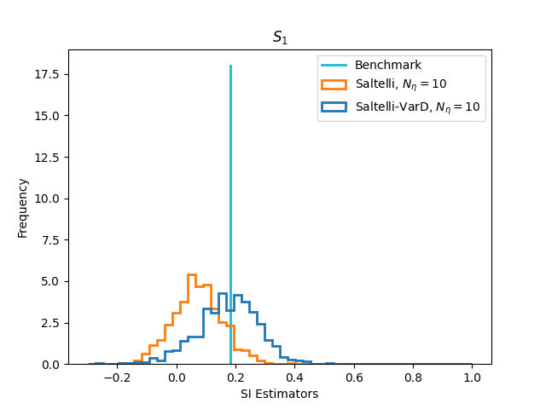
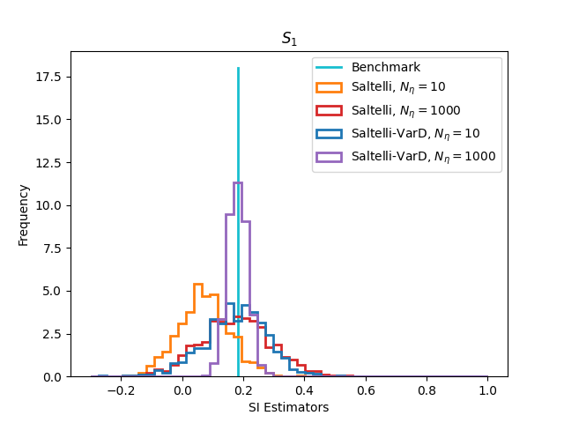
Distributions over 25000 repetitions
First-order SI for cosine of beam incident angle

Slide 57
Distributions over 25000 repetitions
First-order SI for cosine of beam incident angle

Slide 58
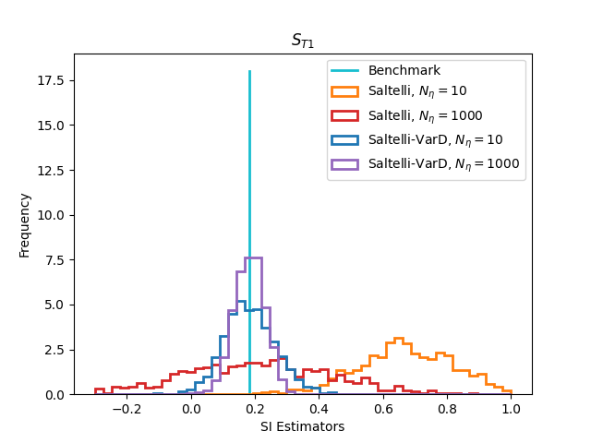
Distributions over 25000 repetitions
Total SI for cosine of beam incident angle

Slide 59
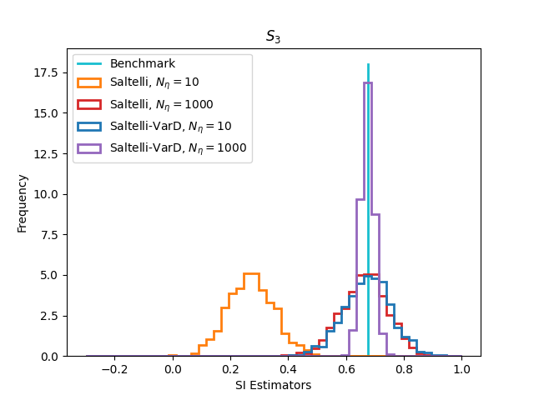
Distributions over 25000 repetitions
First-order SI for total cross section

Slide 60
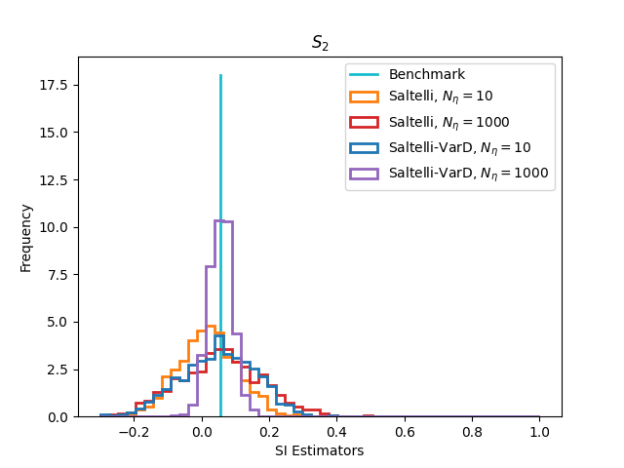


Distributions over 25000 repetitions

Slide 61

results over 25000 repetitions
Saltelli method vs. Saltelli modified with variance deconvolution (Saltelli-VarD)
 | Benchmark | Saltelli |  | Saltelli-VarD
$$N_{η}$$ |  | $$10$$ | $$1000$$ | $$10$$ | $$1000$$
$$S_{3}$$ | 0.6752(2) | 0.27(8) | 0.66(8) | 0.67(8) | 0.67(2)

Slide 62

Conclusions
Saltelli Method modified with variance deconvolution yields accurate results for global sensitivities
Modification is more efficient than over-resolving stochastic solver
Non-intrusive: no changes needed to stochastic solver or sample generation
Only additional data required is $N_{ξ}$ solver variances
future work
Apply variance deconvolution to additional Saltelli sampling estimators
More complex radiation transport applications

Slide 63
references
A. Saltelli et al. Global Sensitivity Analysis: The primer. John Wiley & Sons (2008).
K. Clements, G. Geraci, and A.J. Olson. “Numerical investigation on the performance of a variance deconvolution estimator.” Transactions of the American Nuclear Society Annual Meeting, vol 126, pp. 344-347 (2022).
A. Saltelli et al. “Variance based sensitivity analysis of model output. Design and estimator for the total sensitivity index.” Journal of Computer Physics Communications, vol 181, pp. 259-270 (2009). doi: 10.1016/j.cpc.2009.09.018.

Slide 64
Questions

Slide 65

results over 25000 repetitions
Saltelli method vs. Saltelli modified with variance deconvolution (Saltelli-VarD)
 | Benchmark | Saltelli |  | Saltelli-VarD
$$N_{η}$$ |  | $$10$$ | $$1000$$ | $$10$$ | $$1000$$
$$S_{1}$$ | 0.1824(4) | 0.07(8) | 0.2(1) | 0.2(1) | 0.18(3)
$$S_{2}$$ | 0.0549(4) | 0.02(9) | 0.1(1) | 0.0(1) | 0.06(3)
$$S_{3}$$ | 0.6752(2) | 0.27(8) | 0.66(8) | 0.67(8) | 0.67(2)
$$T_{1}$$ | 0.1835(8) | 0.7(2) | 0.2(2) | 0.18(8) | 0.18(5)
$$T_{2}$$ | 0.1424(8) | 0.7(2) | 0.2(3) | 0.14(8) | 0.14(5)
$$T_{3}$$ | 0.7623(7) | 0.9(1) | 0.8(2) | 0.8(1) | 0.76(4)

Slide 66

Radiation transport test problem
First-order SI for cosine of beam incident angle

Slide 67

Radiation transport test problem
Total SI for cosine of beam incident angle

Slide 68

Radiation transport test problem
First-order SI for material boundary location

Slide 69

Radiation transport test problem
Total SI for material boundary location

Slide 70

Radiation transport test problem
First-order SI for total cross section

Slide 71

Radiation transport test problem
Total SI for total cross section

